Slide 1
Content
S. No. | Index | Page no.
1 | Problem Statement | 3
2 | Architecture Design | 4
3 | Functional Blocks, Entities and Databases | 18
4 | Libraries and Header files | 28
5 | System Requirements | 28
6 | Drive link Information | 29
7 | Instructions for the Execution Steps | 33
8 | Mechanism of Communication between Process blocks | 34
9 | Sample Output | 36

Slide 2
Problem Statement
We need to modify our previous solution to meet the following new demands:
The solution consists of two new main blocks- i) Labelling Block
ii) Tracing & Computation Block
The Labelling Block in each iteration will fetch two thresholded pixels from the Filtering & Threshold Block and assigns a suitable label to each given pair of pixels. Only pixels having thresholded value as '1' will be labelled. The block also identifies connected components that need to be merged with the assigned label of the pixel.
The Tracing & Computation Block in each iteration will fetch from the Labelling Block the two labelled pixels along with all those labels that need to be merged with the assigned label of that pixel. After this, the block would update the information of the assigned label and also merge the connected labels with this label. Also, if any label has no further chance of getting connected to other labels, this block will reset the attributes of that label and recycle that label.
Constraints:
i) Only one row length 'm' of past labelled values can be stored in 16 bit unsigned integers datatype.
ii) For storing index of the labels and their reference to the other labels, at-max two 1D arrays can be used of maximum size m/2.

Slide 3
Architecture Design

Slide 4
Design Notations
Visible Functional Block
An internal unit directly visible to the end users.
Hidden Functional Block
An abstract internal unit that remains hidden from the end users.
External System
An external unit not directly a part of the proposed system.
External Entity
User or Object that interacts with the proposed system.
Database
A data structure to store end result after data is been processed by some unit.

Slide 5
Process
Controls flow of logical data in a systematic way to deliver required result efficiently.
Represents flow of data from one block to another

Slide 6
Level 0 Design
High-Level Overview

Slide 7
Object
Labelling Block
1) Share details of object
7) Labelled pair of pixels
6) Filtered and Thresholded pair of pixels
Data Generation Block
Process
Filter & Threshold Block
3) Scanned pair of pixels
4) Scanned pair of pixels
2) Retrieve each Row of pixels
5) Filtered and Thresholded pair of pixels
8) Labelled pair of pixels
10) Display info of terminated label
9) Output terminated labels
Tracing & Computation Block
Display Unit

Slide 8
Level 1 Design
Low-Level Overview

Slide 9
Level 1.1 Design
Data Acquisition System

Slide 10
Object
Add Padding
Testing.csv file
1) Share details of object
3) Retrieve each row of pixels
11) Add padding of 0's into Buffer
2) Store details of object
10) Add padding
Data Generation Block
4) Send Row of pixels to Pixel_Generator
Data Acquisition
Generated Buffer
9) Call 'Add Padding Block' if required
12) Store scanned pixels along with their coordinates into Buffer
5) Receive Row of pixels
7) Send scanned pixels for storing into Buffer
8) Receive scanned pixels
Pixel Generator
Store into Buffer
Send
6) Store scanned pair of pixels

Slide 11
Level 1.2 Design
Filter & Threshold System

Slide 12
Remove Padding
Generated Buffer
Thresholded Buffer
6) Removing padding
1) Retrieve scanned pair of pixels for filtering
Filter & Threshold Block
5) Remove padding
13) Store thresholded values of pixels along with their coordinates into buffer
2) Send scanned pair of pixels for filtering
Filter & Threshold
Output.csv
9) Receive scanned pair of pixels for filtering
3) Receive scanned pair of pixels for Processing
11) Receive filtered values of pair of pixels and compute Thresholded value
10) Send filtered values of pair of pixels
7) Stores thresholded pixels in .csv file
12) Send thresholded value of pair of pixels to store into buffer
Compute
Processing
4) Call 'Remove Padding' block to remove padding if any
8) Send scanned pair of pixels to compute filtered values

Slide 13
Level 1.3 Design
Pixel Labelling System

Slide 14
Find Nearby Labels
Thresholded Buffer
Labelled Buffer
1) Retrieve thresholded values of pair of pixels for labelling
5) Find Nearby labels to the given pixel
6) Send Nearby labels of the given pixel
Labelling Block
11) Store labelled values of pixels along with their coordinates and label alterations info into buffer
2) Send thresholded values of pixlels for assigning them labels.
10) Send the labelled pixel's info along with the label alterations that took place in current iteration.
Labelling
Update Previous Row and Label
12) Update previous row and label.
9) Fetch the connected labels
13) Update previous row and label.
Label Alterations
3) Receive thresholded pair of pixels for labelling
8) a) ii) Find connected components to the given label assigned to the pixel
4) Find Nearby labels to the given pixel
8) a) i) Find Connected components to the assigned labels if nearby labels are present for the given pixel
8) a) iii) Store the connected labels into 'Set' data structure
7) Receive Nearby Labels and assign label to the given pixel
Find Connected Labels
Assign and Connect
8) b) Assign label from the free labels if there are no nearby labels to the given pixel
Available Labels

Slide 15
Level 1.4 Design
Tracing & Computation System

Slide 16
Recompute Label Attributes
Display Unit
Labelled Buffer
1) Retrieve labelled values of pair of pixels along with label alterations
7) Update root label's info
Tracing & Computation Block
20) Display info of the terminated root label
2) Find root label of the assigned label
6) Update root label's info
8) Merge connected labels
12) Recycle labels
Change Reference
5) Receive root label
Tracing & Computation
11) Merge label to its root label and update root label's info
Available Labels
13) Recycle terminated labels
17) Receive root label of the given label
9) Merge connected labels
3), 15) Compress paths of the labels if possible and find root label of the given label.
18) Recycle label if it's root label has terminated
14) Find root label for each label
19) Display lterminated label 's info if it is root node
10) Call Change Reference module
4), 16) Send root label of the given label
Recycle
Merge Labels
Path Compression

Slide 17
Functional Blocks, Entities and Databases

Slide 18
There were total of 13 functional blocks, entities and databases in the previous proposed solution. Now, 16 more functional blocks, entities and databases are added in the modified solution as shown below:
Labelling Block
Assign and Connect
Thresholded Buffer
Output.csv
Find Nearby Labels
Find Connected Labels
Available Labels
Label Alterations
Update Previous Row and Label
Tracing & Computation Block
Path Compression
Labelled Buffer
Recompute Label Attributes
Merge Labels
Change Reference
Recycle

Slide 19
This .csv file will store the thresholded values of each and every pixel generated in the Filtering & Threshold Block.
Output.csv
It is a deque data structure. Each index in this deque contains a vector that stores 3 information related to the thresholded pixel generated in the Filtering & Threshold Block:
i) threshold value of the pixel
ii) column no. of the thresholded pixel
iii) row no. of the thresholded pixel
Thresholded Buffer
Labelling Block
This is one of the 4 fundamental block in our proposed system and is responsible for assigning label to the given thresholded pixel. Along with this, the block also stores the nearby connected labels to the given pixel in Label_Alternations set data structure so that these labels can be merged with the assigned label of the given thresholded pixel. If no labels are present nearby to the given pixel, the block assigns a new label to the pixel from Available_Labels queue data structure. In the end, the block stores the labelled value of the pixel along with its row and column number and the Label_Alterations set into Labelled_Buffer deque data structure. The block only utilizes one previous row while assigning labels to the pixels. Once the label has been assigned and information is been stored into Labelled_Buffer, the block simultaneously updates value at the corresponding index in the previous row.

Slide 20
Assign and Connect
This block first ensures that only those pixel would be assigned non-zero labels whose thresholded values are 1. If thresholded value is 0 then that pixel would be assigned label 0. Otherwise, every non zero thresholded pixel will be assigned non-zero label. This block then calls Find_Nearby_Labels module to store the label values of four nearby pixels to the given pixel in the Nearby_Labels vector data structure. After storing the nearby labels, the block assigns the given label the first non-zero label value from the Nearby_Labels. Once the label is been assigned to the given pixel, this block calls Find_Connected_Labels to find any connected component nearby the given pixel.
Note that if there are no non-zero labels present in the Nearby_Labels vector, then this block will assign a new label to the given pixel from Available_Labels queue.
Find Nearby Labels
This block finds and stores the labels of 4 nearby pixels to the given pixel:
i) left ii) top iii) top left iv) top right
This is a queue data structure that stores all the currently free/available labels.
Available Labels

Slide 21
Find Connected Labels
This block finds and stores the labels that needs to be merged with the assigned label of the given pixel. This block stores all the non-zero labels other than the assigned label present in the Nearby_Labels vector into Label_Alterations set data structure.
It is a set data structure that stores all the labels that are connected with the assigned label and needs to be merged with it.
Label Alterations
It is a deque data structure. Each index in this deque contains a pair. Each pair contains 2 structures: i) a vector ii) a set
The vector in the pair consists of following 3 information related to the labelled pixel generated in Labelling Block:
i) threshold value of the pixel
ii) column no. of the thresholded pixel
iii) row no. of the thresholded pixel
The set in the pair is nothing but Label_Alternations set that contains all those labels to be merged with the assigned label.
Labelled Buffer

Slide 22
Update Previous Row and Label
After the given pixel is assigned its label, this block overwrites the consecutive index of the previous row with the previous label (the pixel belonging to the current row that was previously been labelled) and sets the previous label to the given label.
Tracing & Computation Block
This is one of the 4 fundamental block in our proposed system and is responsible for updating label's information like its coordinates, total count of pixels assigned to that label and the reference which that particular label is making with the other labels.
When a new pixel arrives, the root label of the assigned label to that pixel is determined using Path Compression module. After identifying the root label, its coordinates are updated and its count is incremented by 1.
After that, the block merges all the labels present in the Label_Alterations set with the root label of the assigned label using Change_Reference module. Once all this is been done, the block checks if the given pixel belongs to the last column of a row or not. If yes, the block will call Recycle module to detect and recycle all those labels that have no further possibility of getting connected to the future labels.

Slide 23
Path Compression
This block compresses the path of all the labels between 'given' label and its 'root', i.e, Reference[i] will directly point to its 'root' label which previously was forming long chain. In the end, the block returns the 'root' label to the 'given' label which signifies that the 'given' label is been merged with the 'root' label.
# Note: Reference[x-1] = y means that label 'x' is merged with the root label 'y'.
root
root
1
1
5
5
2
3
Applying Path Compression on node 3
2
6
6
4
3
7
7
4

Slide 24
Recompute Label Attributes
Updates the top most, left most, right most and bottom most coordinates of the given label as per the coordinates of the given label and increment the count of the label by 1.
Merge Labels
For each label 'x' present in the Label_Alterations set, this block calls the Change_Reference module that merges the label 'x' with the 'replacing label'.

Slide 25
Change Reference
This block performs path compression for all the labels between the path of label to be replaced and replacing label by referring all those labels directly to the 'replacing label' . Once the root of the label to be replaced is found out, the block merges the root to the replacing label and updates the information of the replacing label.
root 1
root 2
root 2
root 1
Calling 'Change_Reference' module to merge label 2 with root 2:
1
4
1
2
4
2
5
3
5
3
6
6

Slide 26
Recycle
This block is called after end of each row. The block iterates over all the labels and checks whether any label any terminated or not. For this the block checks the bottom most coordinate of the root of that label and if the bottom most coordinate of the root of that label is not a part of current row, it means that the label (and its root) has no further possibility of getting connected. This block will then reset the attributes of that label and push the label back into the Available_Labels queue. If that label is actually the root then the block will also display the information of that root label.

Slide 27
Libraries and Header files
Only one additional header file was been used in the modified solution:
# include <bits/stdc++.h>: It is a header file that includes every standard library.
Here we have used it to include STL containers like 'Set', 'Queue', 'Deque', etc.
System Requirements
System requirements remain the same for this modified solution.

Slide 28
Drive Link Information
Drive Link: https://drive.google.com/drive/folders/1XSllKx-xI3Baljr9wOILriWg9lqKgQ2Q?usp=sharing

Slide 29
The Drive link consists of 1 file and 2 folders. These are:
1) Solution using Thread : Here, thread library is been used (but not inbuilt std thread library) and threads of all the 4 blocks have been created so that these 4 blocks run simultaneously. The iterations of the 4 blocks may or may not be synchronous.
2) Solution without using Thread: This version of Code does not use thread. Instead, in each iteration the 4 blocks will run sequentially one after the other. This version is been implemented since some C++ versions and compilers does not support threading.
3) Modified_Design_Overview.pptx

Slide 30
The 'Solution using Thread' and 'Solution without using Thread' folders both consists of the following files and folders:
1) CSV Files: Consists of 3 .csv files :
i) Random_generator_mode.csv : Stores random sequences of pixels generated when the program runs in Random Generator Mode.
ii) Testing_mode.csv : Stores the input pixels. The program reads input from this file when run in Test Mode.
iii) Output.csv : Stores the thresholded values of pixels in the form of 0's and 1's.
2) Main_Test_Mode.cpp : The main file to run C++ program in Test Mode.
3) Main_Random_Generator_Mode.cpp : The main file to run C++ program in Random Generator Mode.
# Note: 2) and 3) files both consists of 4 main modules:
i) Data_Generation_Block
ii) Filter_and_Threshold_Block
iii) Labelling_Block
iv) Tracing_and_Computation_Block

Slide 31
4) Data_Generation.cpp : Consists of Pixel_Generator module required by Data_Generation block.
5) Data_Filtering_and_Threshold.cpp : Consists of 2 modules required by Filter_and_Threshold Block: i) Compute module and ii) Processing module
6) Buffer_Storing_and_Padding.cpp : Consists of Store_into_Buffer module for storing elements into the buffer and adding/removing padding to/from the buffer .
7) Pixel_Labelling.cpp : Consists of Assign_and_Connect, Find_Nearby_Labels, Find_Connected_Labels and Update_Previous_Row_and_Label modules for labelling the pixels.
8) Tracing_and_Computation.cpp : Consists of Merge_Labels, Change_Reference, Path_Compression, Recompute_Label_Attributes and Recycle modules for merging and updating label's information.
# Note: The 'Solution using Thread' folder also consists of 1 additional 'Dependencies' folder which consists of external 'MinGW-w64' compatible libraries required for threading.
# Note: Sample test input .csv file is 'Testing_mode.csv' present inside 'CSV Files' folder. This is also the file that our program will read in Test Mode.

Slide 32
Instructions for the Execution Steps
Instructions are same as that given in previous solution. But this time the terminal won't display the thresholded values of the pixels. Instead, the terminal would display the information pertaining to each label (i.e, coordinates of the smallest encompassing rectangle of the label and total count of elements in that label).
The thresholded values of the pixels would instead be stored in the 'Output.csv' for both Testing Mode and Random Generator Mode file present inside the following directories:
CynLr\Solution using Thread\CSV Files
CynLr\Solution without using Thread\CSV Files

Slide 33
Mechanism of Communication between process blocks

Slide 34
Available Labels
int done_Data_Generation
int done_Filter_and_Threshold
int done_Labelling
Data Acquisition
Filter & Threshold
Tracing & Computation
Labelling
Generated Buffer
Thresholded Buffer
Labelled Buffer

Slide 35
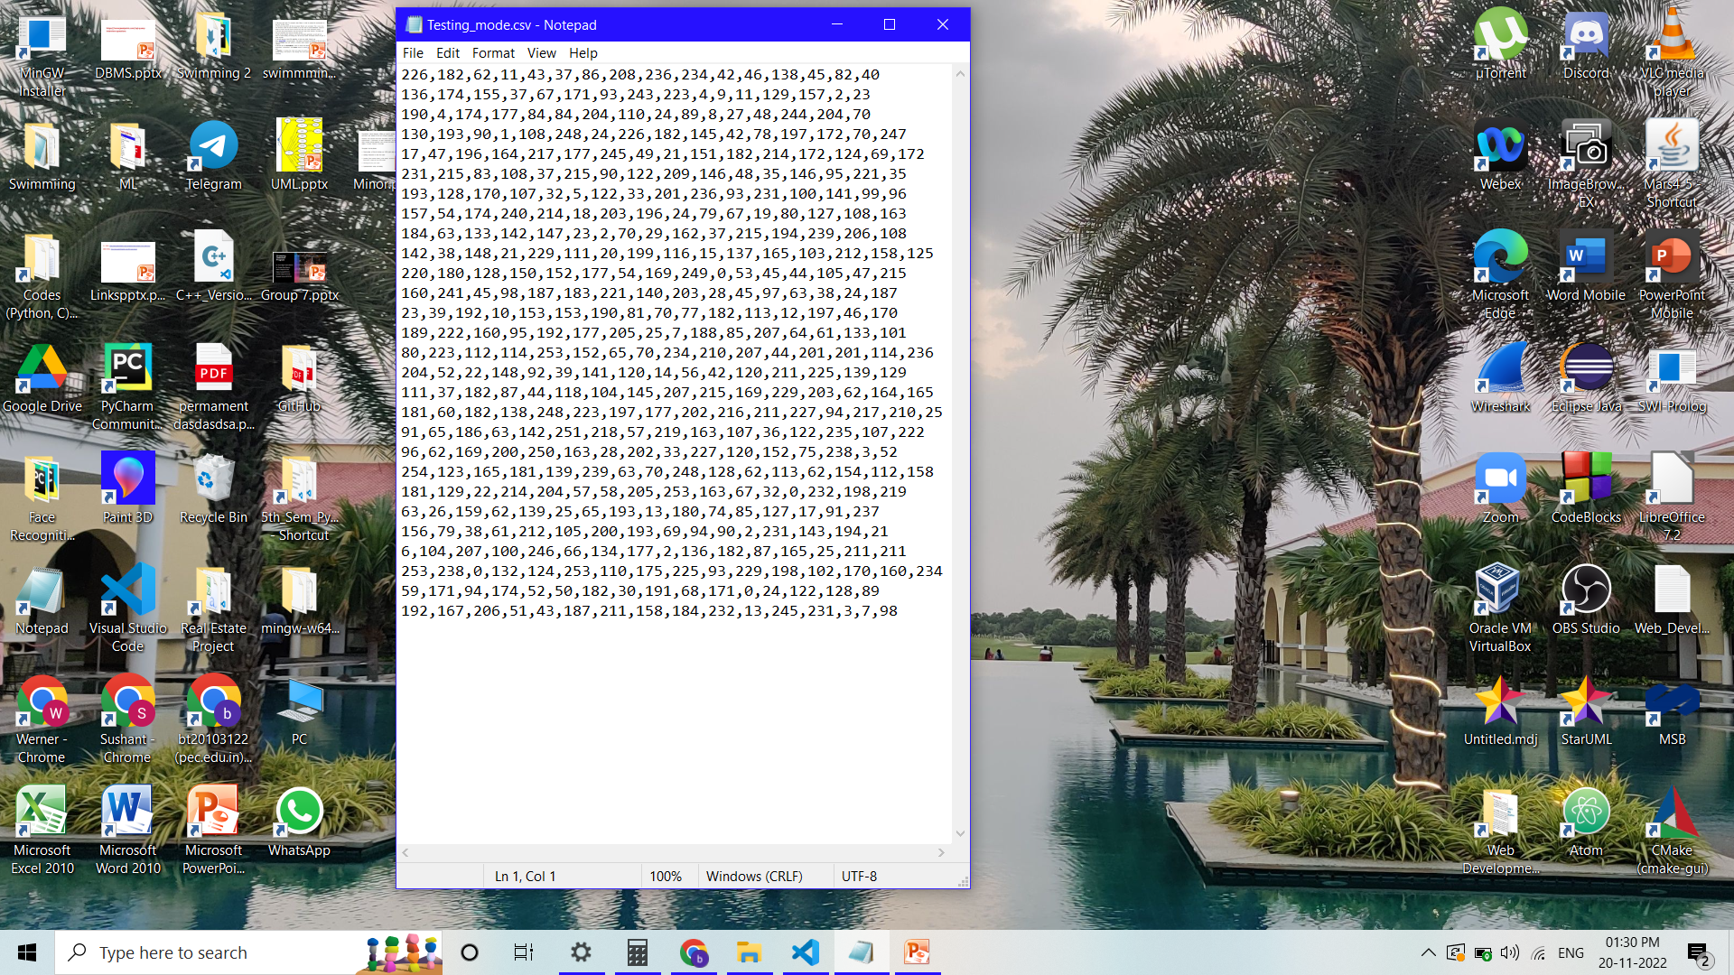
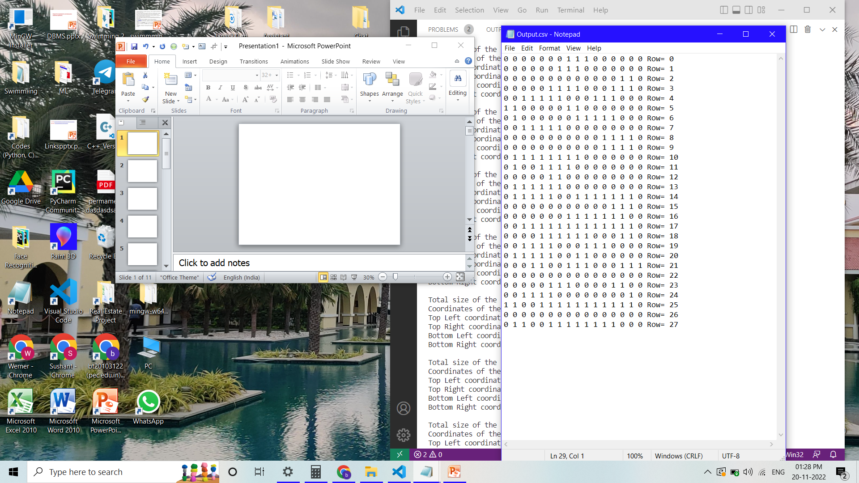
Sample Output
Testing_mode.csv
Output.csv

Slide 36
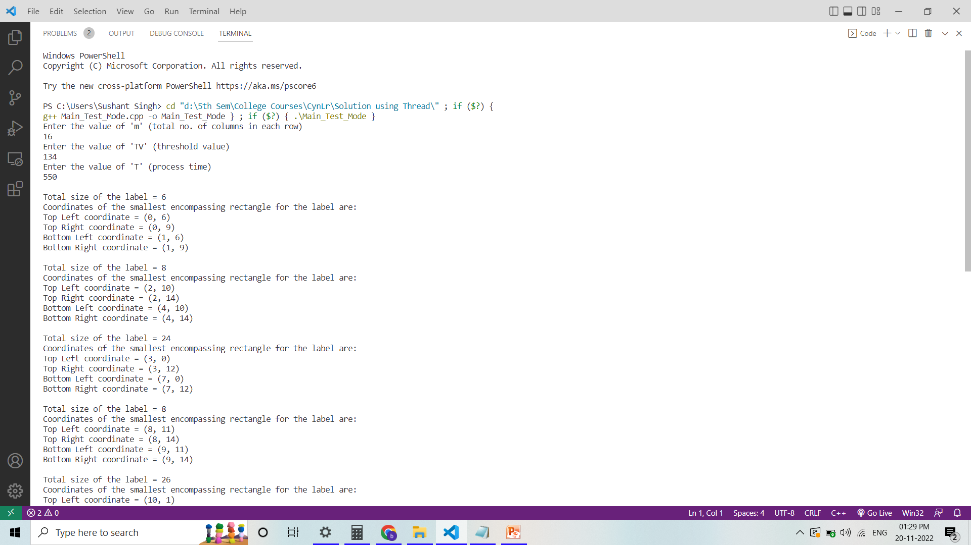
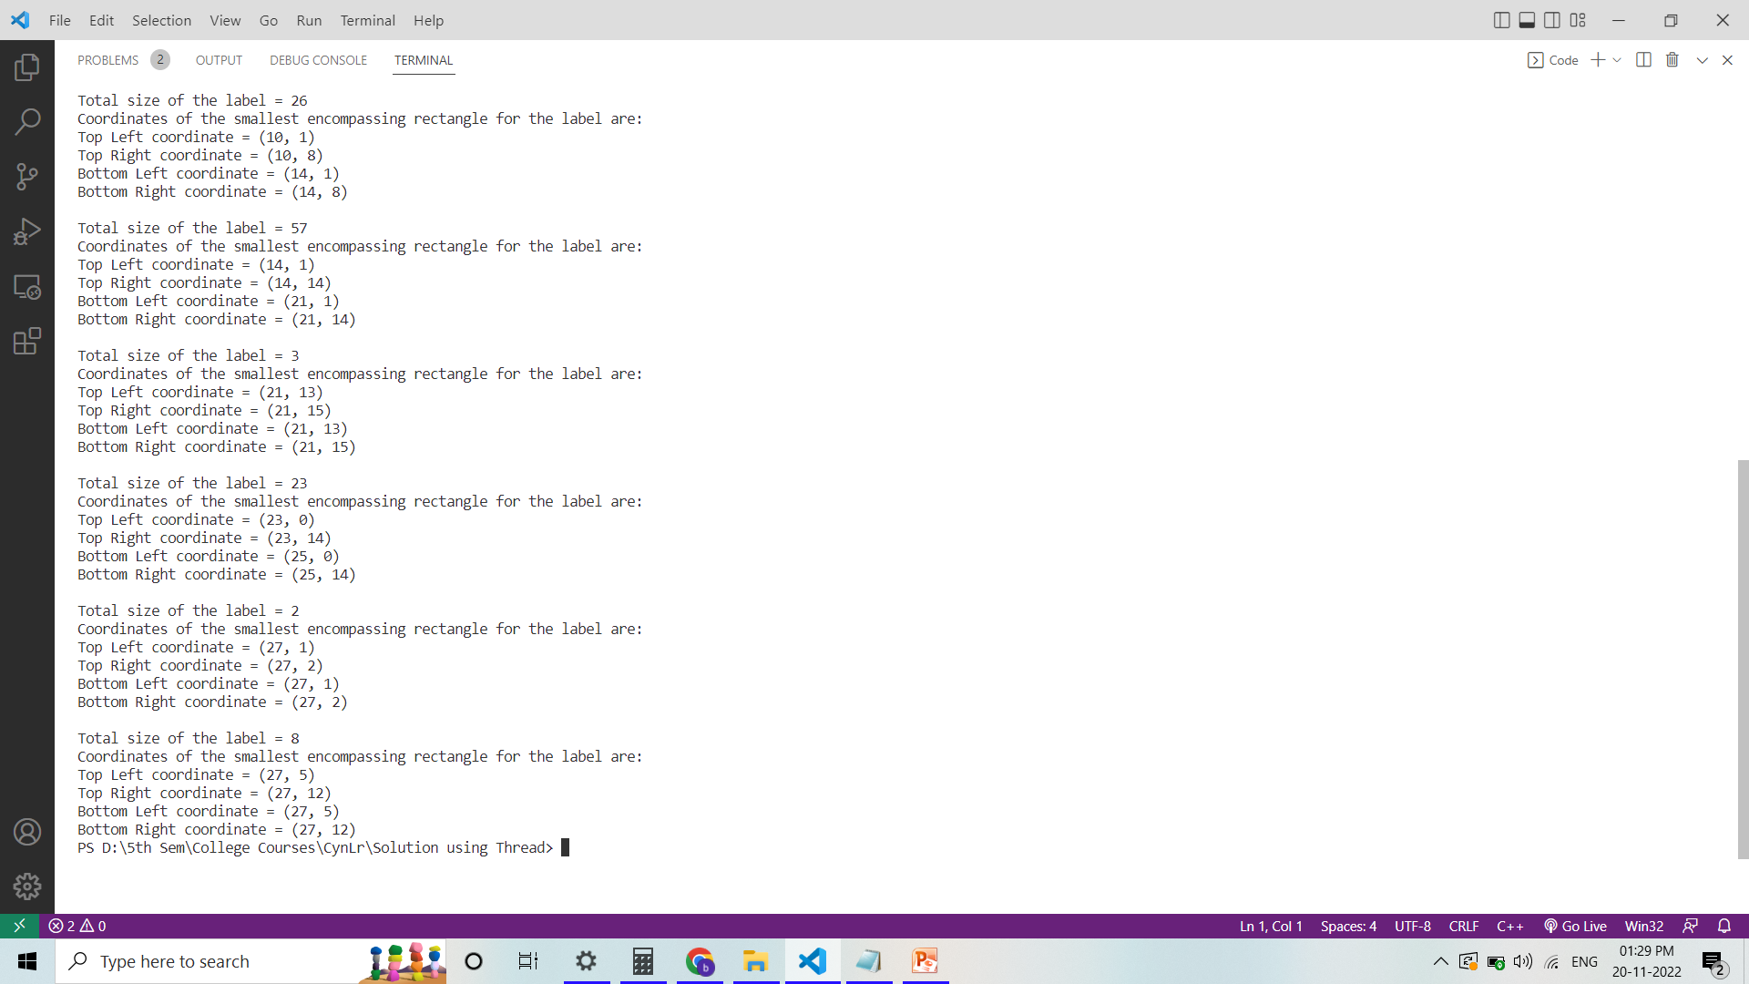
Terminal:

